Slide 1
Goal-directed joint action: an event with two or more agents which, taken as a whole, is directed to a goal.

Slide 2
Goal-directed joint action: an event with two or more agents which, taken as a whole, is directed to a goal.

Slide 3

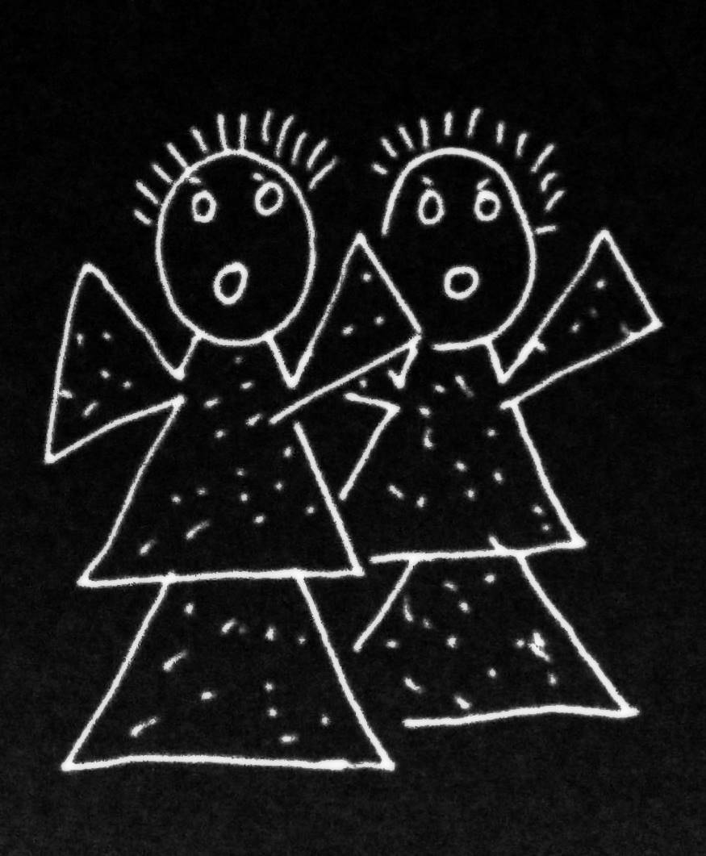
Goal-directed joint action: an event with two or more agents which, taken as a whole, is directed to a goal.

Slide 4
Goal-directed joint action: an event with two or more agents which, taken as a whole, is directed to a goal.

Slide 5
Goal-directed joint action: an event with two or more agents which, taken as a whole, is directed to a goal.
out
out
act
out
act
out

Slide 6
Goal-directed joint action: an event with two or more agents which, taken as a whole, is directed to a goal.
out
out
act
represents
coordinates
out
act
shared intention
out

Slide 7
Goal-directed joint action: an event with two or more agents which, taken as a whole, is directed to a goal.
???
out
out
act
represents
coordinates
out
act
shared intention
out

Slide 8
Goal-directed joint action: an event with two or more agents which, taken as a whole, is directed to a goal.
G is a distributive goal: it is an outcome to which each agent’s actions are individually directed and it is possible that: all actions succeed relative to this outcome.

Slide 9
Goal-directed joint action: an event with two or more agents which, taken as a whole, is directed to a goal.
G is a distributive goal: it is an outcome to which each agent’s actions are individually directed and it is possible that: all actions succeed relative to this outcome.
Nora’s shooting
Fred’s death
Olive’s shooting
Fred’s killing

Slide 10
Goal-directed joint action: an event with two or more agents which, taken as a whole, is directed to a goal.
G is a distributive goal: it is an outcome to which each agent’s actions are individually directed and it is possible that: all actions succeed relative to this outcome.
G is a collective goal
(a) it is a distributive goal;
(b) the actions are coordinated; and
(c) coordination of this type would normally facilitate occurrences of outcomes of this type.

Slide 11
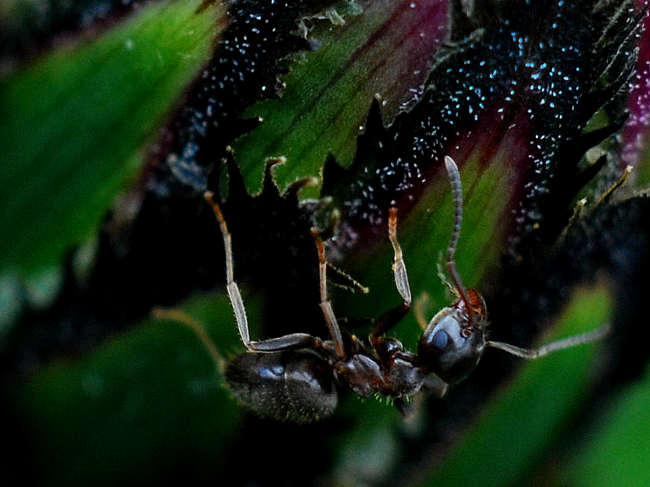

Slide 12
sting
sting
sting
sting
sting
death of fly
sting
sting
sting

Slide 13
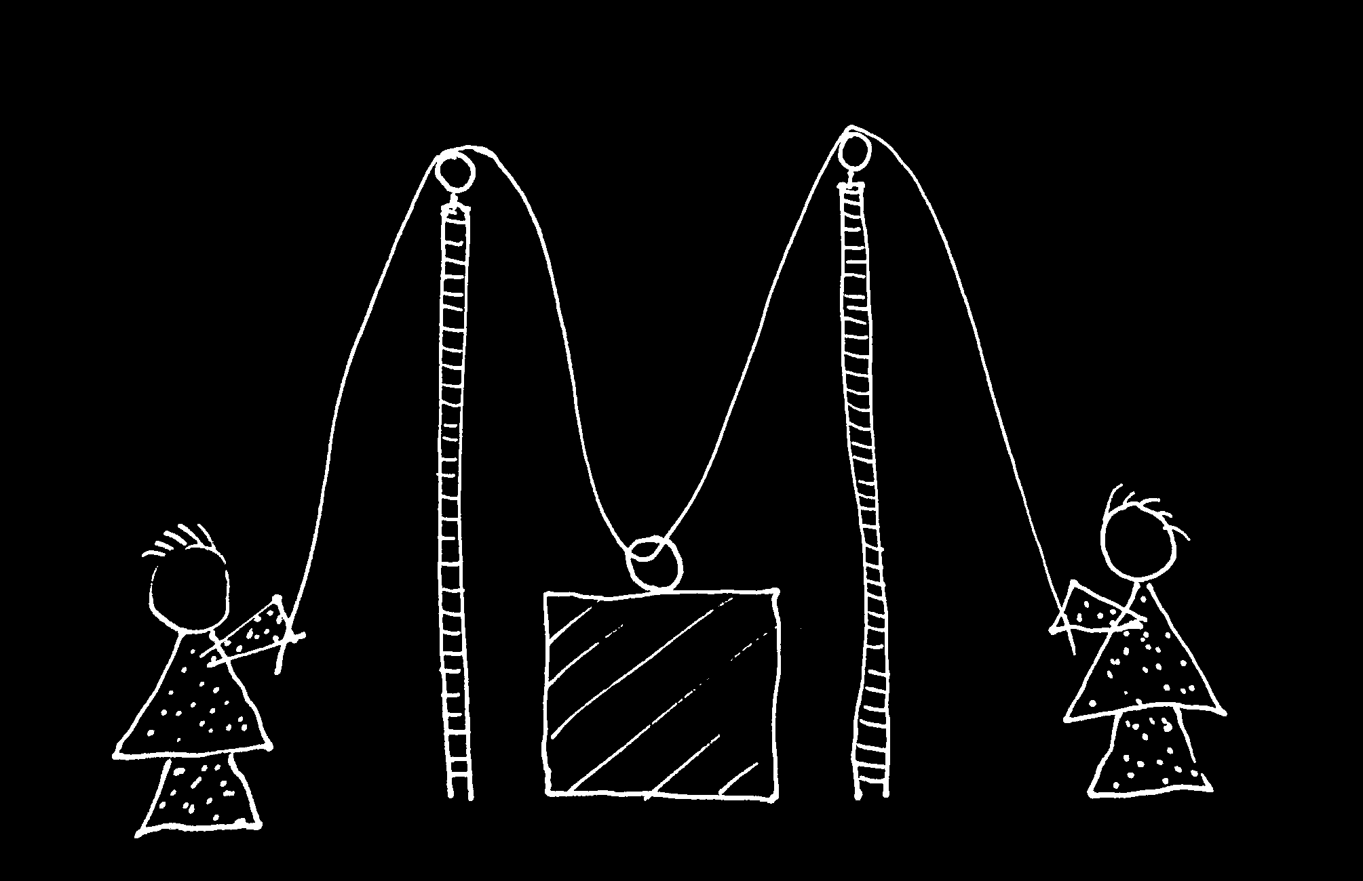

Slide 14
Goal-directed joint action: an event with two or more agents which, taken as a whole, is directed to a goal.
G is a distributive goal: it is an outcome to which each agent’s actions are individually directed and it is possible that: all actions succeed relative to this outcome.
G is a collective goal
(a) it is a distributive goal;
(b) the actions are coordinated; and
(c) coordination of this type would normally facilitate occurrences of outcomes of this type.

Slide 15
Goal-directed joint action: an event with two or more agents which, taken as a whole, is directed to a goal.
G is a distributive goal: it is an outcome to which each agent’s actions are individually directed and it is possible that: all actions succeed relative to this outcome.
G is a shared goal
G is a collective goal
(a) it is a distributive goal;
(b) the actions are coordinated; and
(c) coordination of this type would normally facilitate occurrences of outcomes of this type.
Each agent most wants and expects each of the other agents to perform activities directed to the goal.
Each agent most wants and expects the goal to occur as a common effect of all their goal-directed actions.

Slide 16
Goal-directed joint action: an event with two or more agents which, taken as a whole, is directed to a goal.
G is a distributive goal: it is an outcome to which each agent’s actions are individually directed and it is possible that: all actions succeed relative to this outcome.
G is a shared goal
G is a collective goal
(a) it is a distributive goal;
(b) the actions are coordinated; and
(c) coordination of this type would normally facilitate occurrences of outcomes of this type.
Each agent most wants and expects each of the other agents to perform activities directed to the goal.
Each agent most wants and expects the goal to occur as a common effect of all their goal-directed actions.

Slide 17
Goal-directed joint action: an event with two or more agents which, taken as a whole, is directed to a goal.
G is a distributive goal: it is an outcome to which each agent’s actions are individually directed and it is possible that: all actions succeed relative to this outcome.
G is a shared goal
G is a collective goal
(a) it is a distributive goal;
(b) the actions are coordinated; and
(c) coordination of this type would normally facilitate occurrences of outcomes of this type.
Each agent most wants and expects each of the other agents to perform activities directed to the goal.
Each agent most wants and expects the goal to occur as a common effect of all their goal-directed actions.

Slide 18
Goal-directed joint action: an event with two or more agents which, taken as a whole, is directed to a goal.
G is a distributive goal: it is an outcome to which each agent’s actions are individually directed and it is possible that: all actions succeed relative to this outcome.
G is a shared goal
G is a collective goal
(a) it is a distributive goal;
(b) the actions are coordinated; and
(c) coordination of this type would normally facilitate occurrences of outcomes of this type.
Each agent most wants and expects each of the other agents to perform activities directed to the goal.
Each agent most wants and expects the goal to occur as a common effect of all their goal-directed actions.

Slide 19
Goal-directed joint action: an event with two or more agents which, taken as a whole, is directed to a goal.
etc ...
G is a distributive goal: it is an outcome to which each agent’s actions are individually directed and it is possible that: all actions succeed relative to this outcome.
G is a shared goal
G is a collective goal
(a) it is a distributive goal;
(b) the actions are coordinated; and
(c) coordination of this type would normally facilitate occurrences of outcomes of this type.
Each agent most wants and expects each of the other agents to perform activities directed to the goal.
Each agent most wants and expects the goal to occur as a common effect of all their goal-directed actions.

